Slide 1
← 400nm →
LAFO thin film (20 nm)
400nm
→ ←
Au contact
Au contact
Pt (5nm)
Py (5nm)

Slide 2
← 400nm →
LAFO thin film (x nm)
Au contact
Au contact
← 400nm →
Pt (5nm)
Pt (5nm)
Py (5nm)
Py (5nm)

Slide 3
← 400nm →
LAFO thin film (40 nm)
400nm
→ ←
Au contact
Au contact
Pt (5nm)
Py (5nm)

Slide 4
Au contact
Pt (5nm)
Py (5nm)
LAFO thin film (20nm)

Slide 6
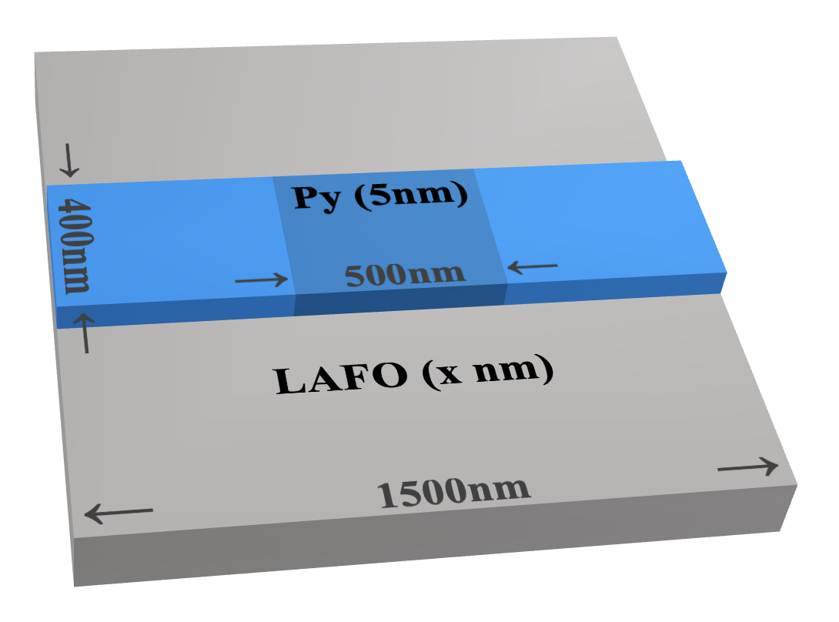
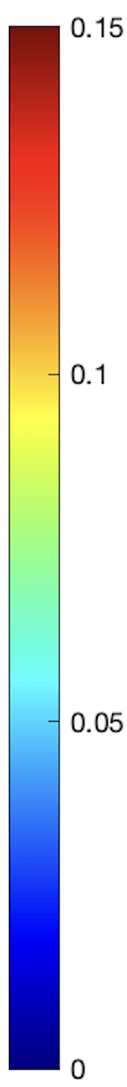




(a)
(b)
EM
BM
max
H
Py5
$$φ$$
$$z$$
J
LAFO10
$$y$$
$$x$$
min

Slide 7
FFT Amplitude (arb. unit)
Thickness (nm)
𝜇₀M_{s} (T)
K_{u} ( kJ/m³ )

Slide 8

LAFO (x nm)
← 1500nm →
(a)
H
→ 400nm ←
Py (5nm)
→ 500nm ←
$$φ$$
$$z$$
J
$$y$$
$$x$$

Slide 9

$$K_{u}=−20kJ/m^{3}$$
EM
BM
max
Py5
LAFO10
min

Slide 10
4
J_{th} ( × 10¹² A/m² )
2
0
Thickness (nm)
𝜇₀M_{s} (T)
K_{u} ( kJ/m³ )

Slide 11
28
24
20
FFT Amplitude (arb. unit)
Thickness (nm)
𝜇₀M_{s} (T)
K_{u} ( kJ/m³ )

Slide 12
4
J_{th} ( × 10¹² A/m² )
(d)
(e)
(f)
24
20
FFT Amplitude (arb. unit)
Thickness (nm)
𝜇₀M_{s} (T)
K_{u} ( × 10⁴ J/m³ )

Slide 13
Frequency (GHz)
K_{u} ( kJ/m³ )

Slide 14
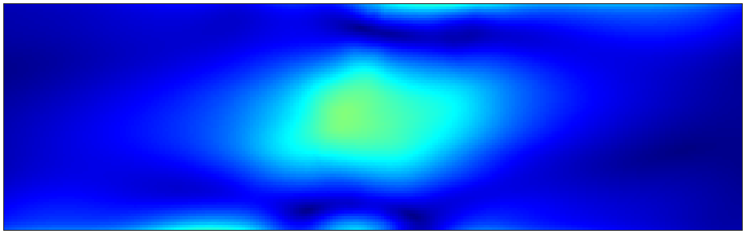
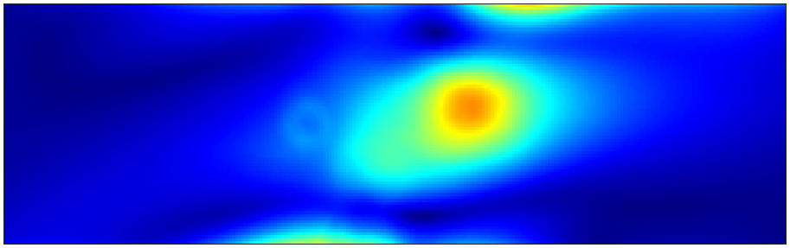
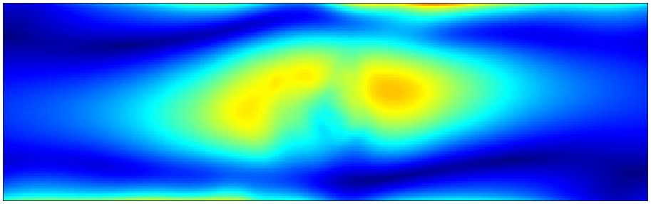
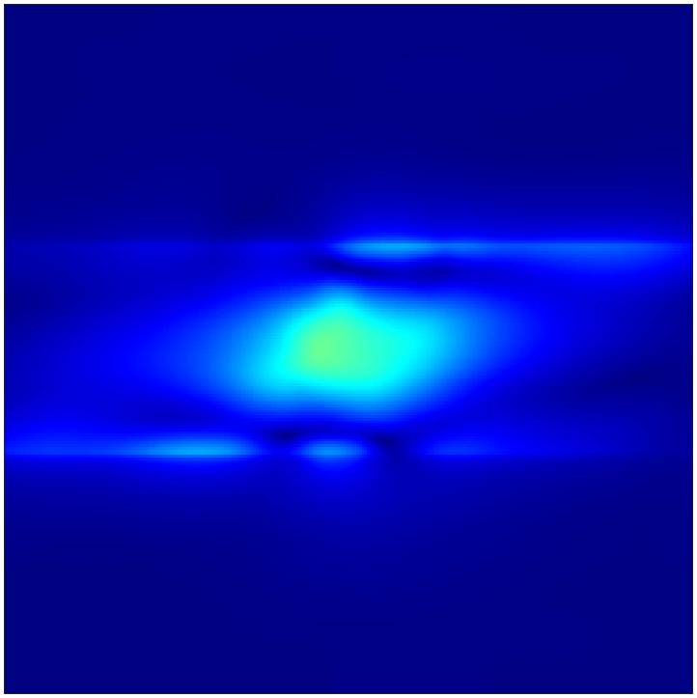
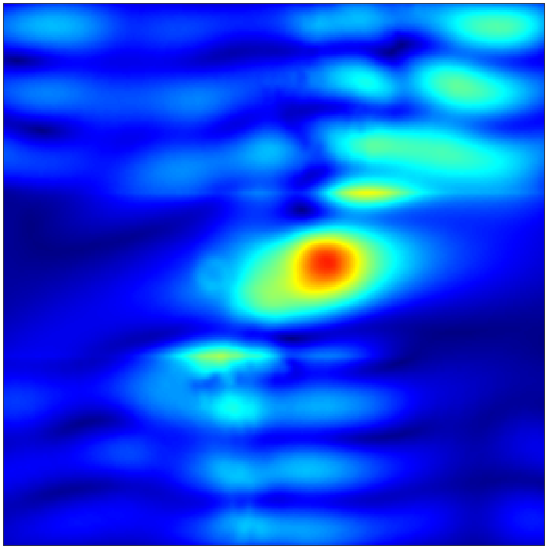
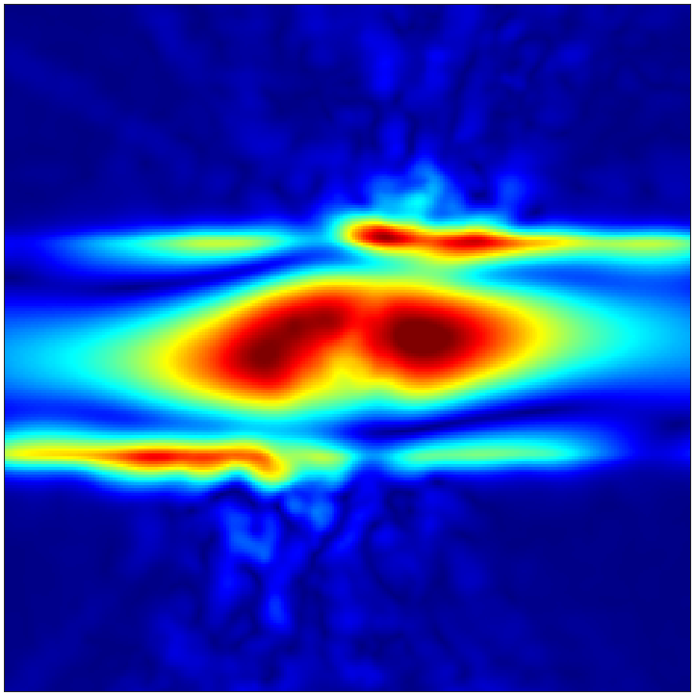
K_{u} = -31.7 kJ/m³
K_{u} = -10 kJ/m³
K_{u} = 15 kJ/m³
max
Py5
LAFO10
min

Slide 15
(a)
(b)
K_{u} = -31.7 kJ/m³
K_{u} = -10 kJ/m³
K_{u} = 15 kJ/m³
max
Py5
Frequency (GHz)
LAFO10
min
K_{u} (kJ/m³ )

Slide 16
Frequency (GHz)
K_{u} ( kJ/m³ )

Slide 17
FFT Amplitude (arb. unit)
𝜇₀M_{eff} (T)

